Slide 1


CRIMES IN INDIA

Slide 2
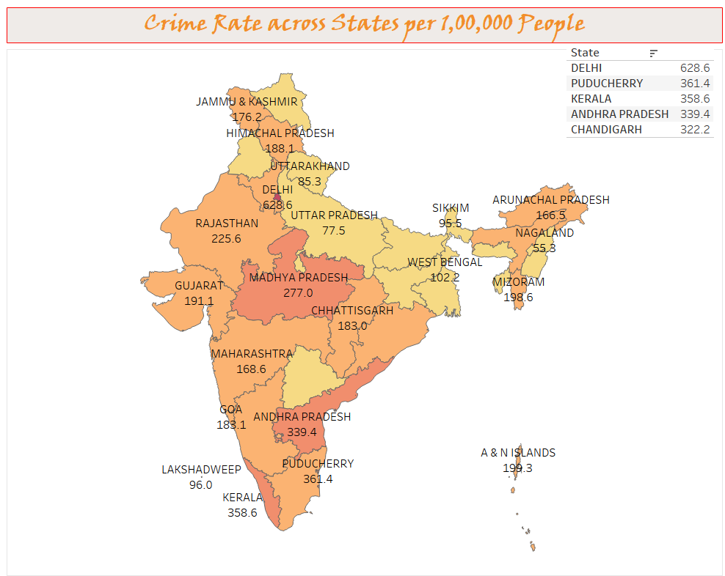

Slide 3
Kidnapping Statistics

Slide 4
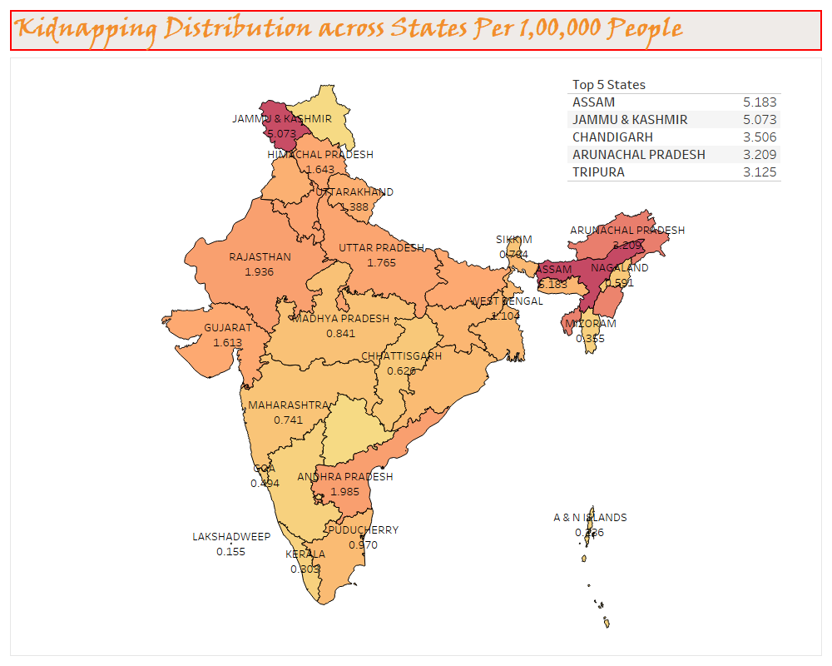

Slide 5
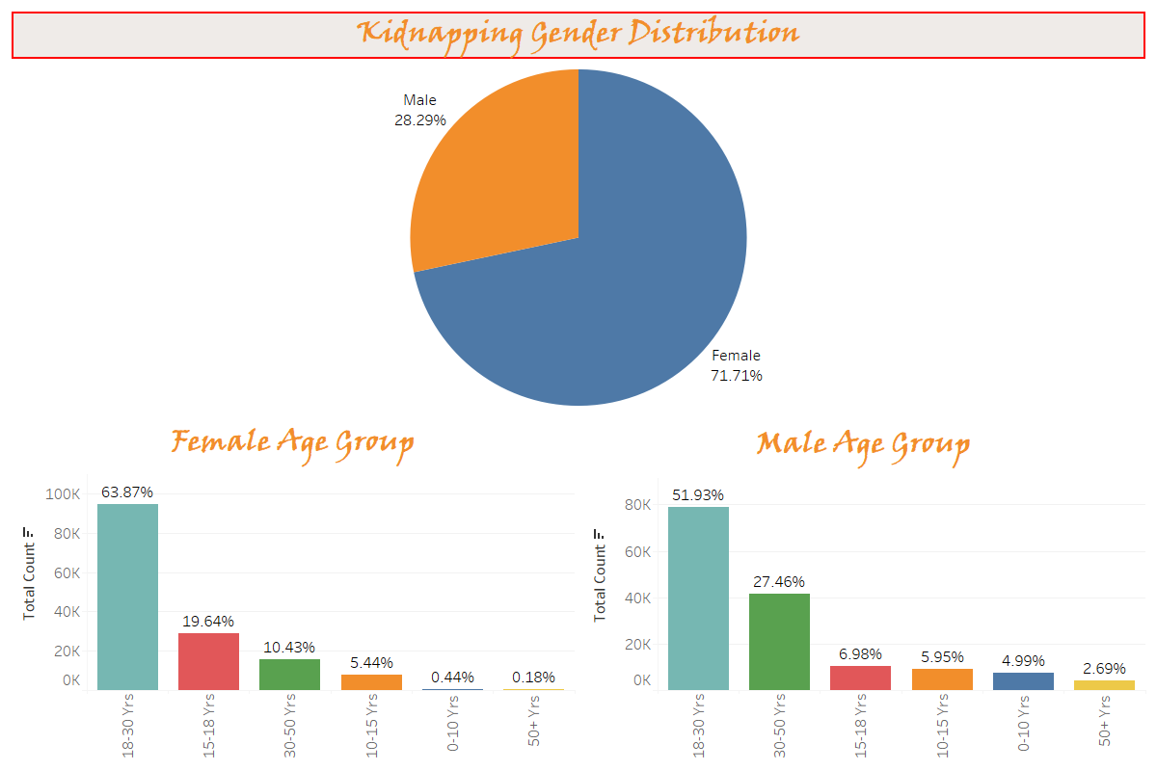

Slide 6
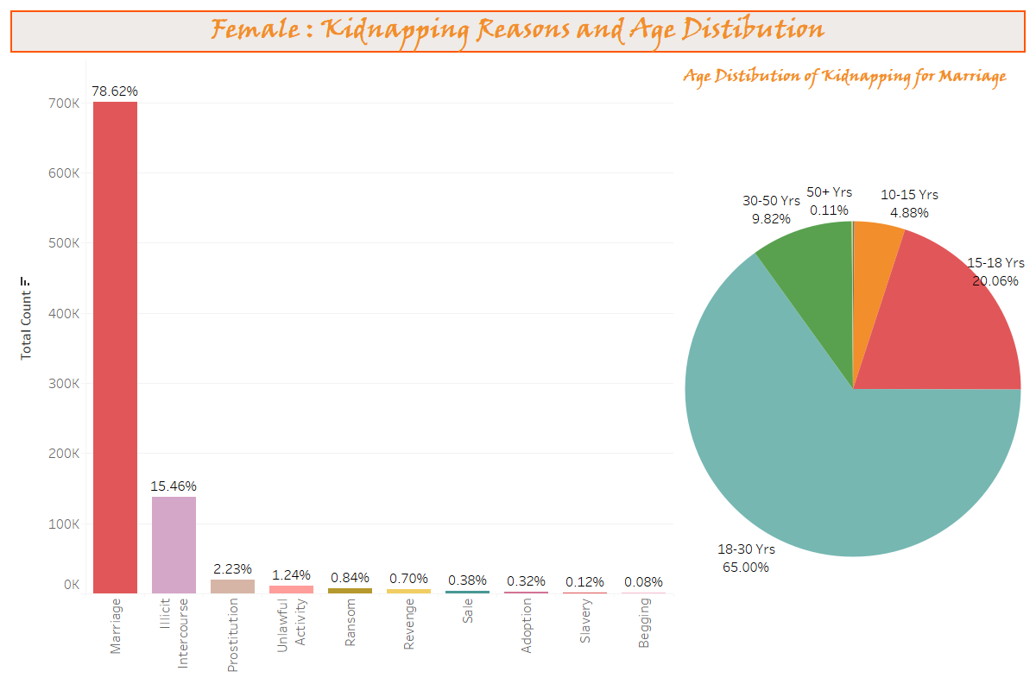

Slide 7
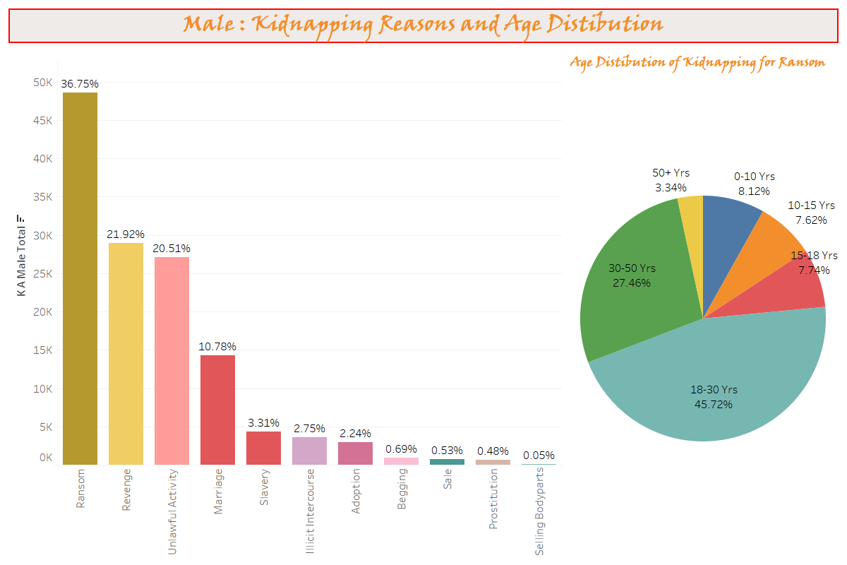

Slide 8
Rape Statistics

Slide 9
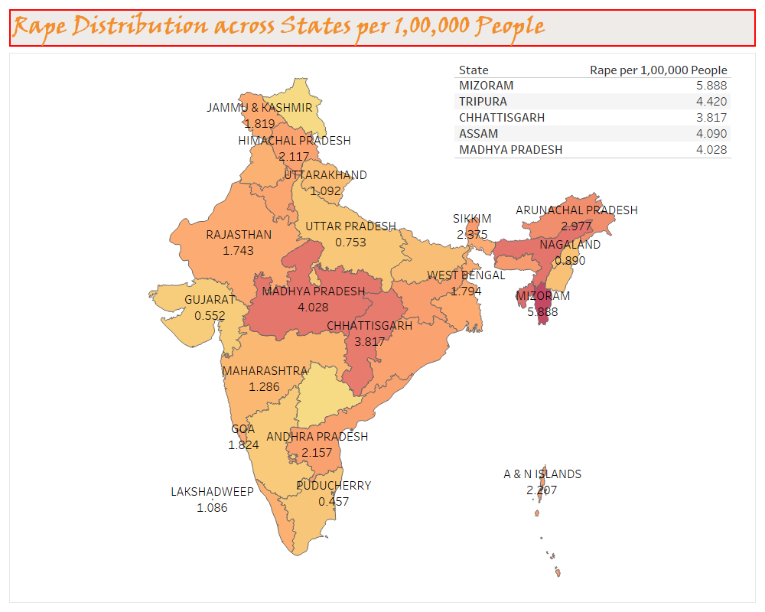

Slide 10
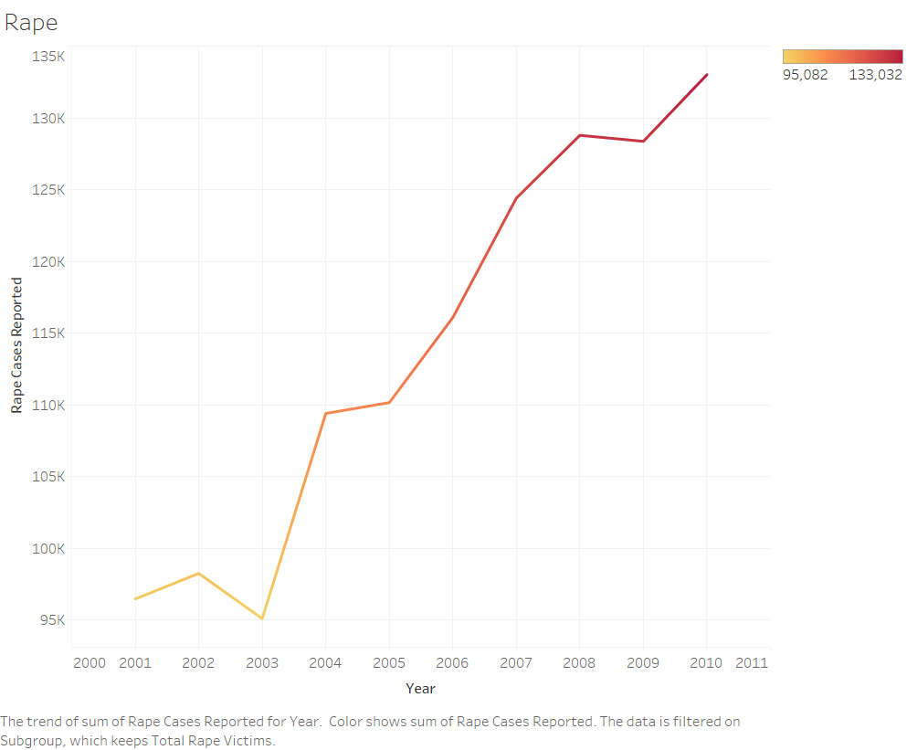

Slide 11
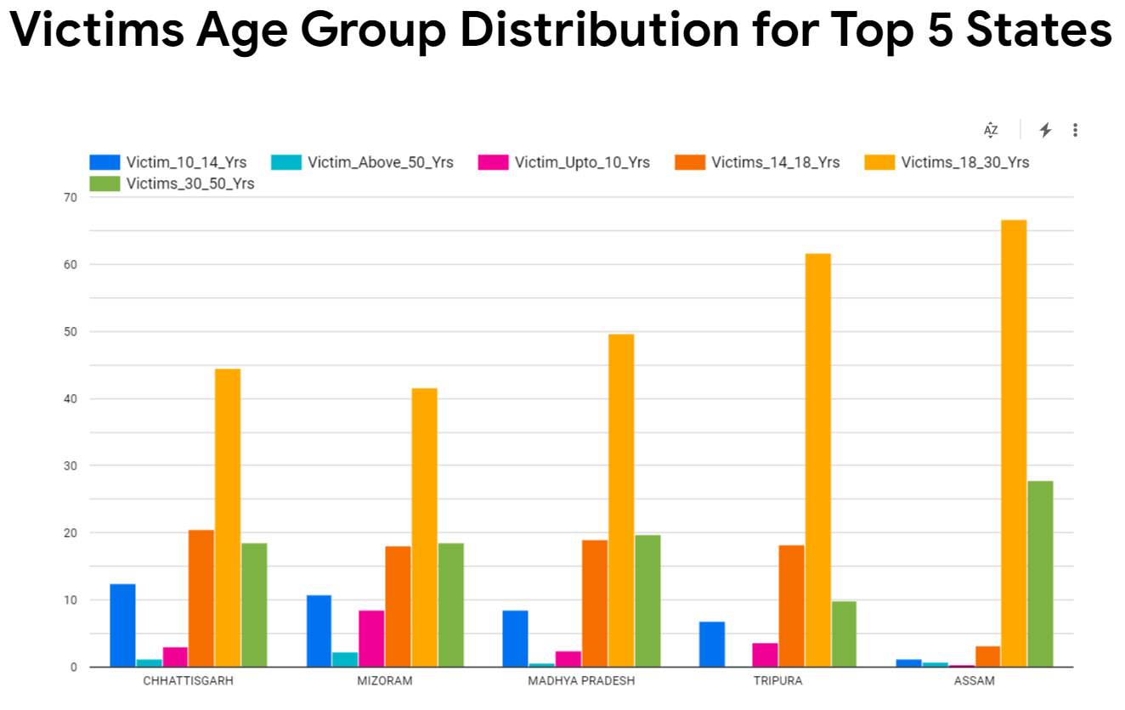
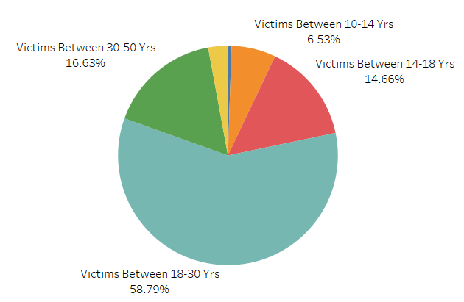
Victims Age Group
Across States

Slide 12
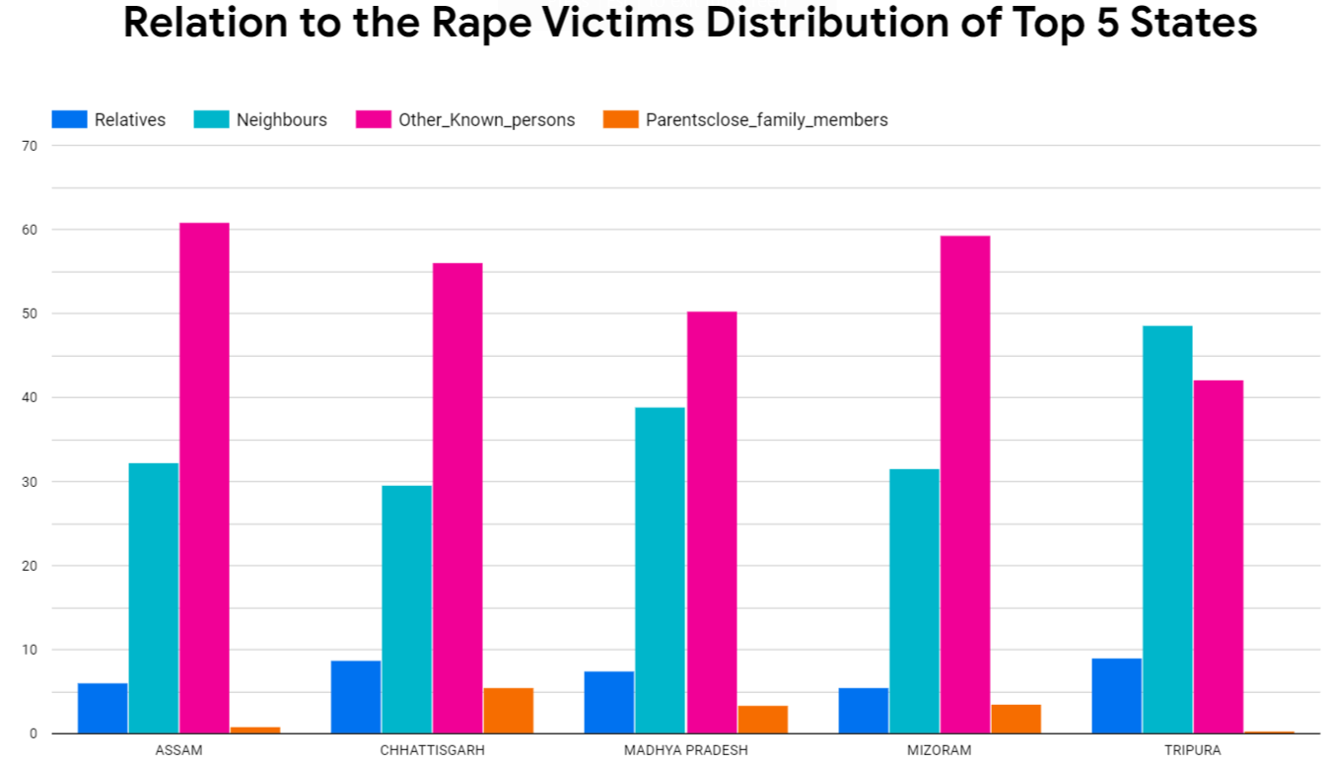
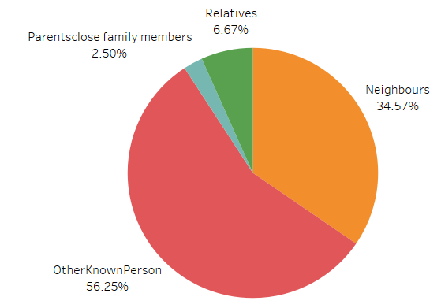
Relation To Victim Distribution
Across States

Slide 13

Crime by Juveniles Statistics

Slide 14
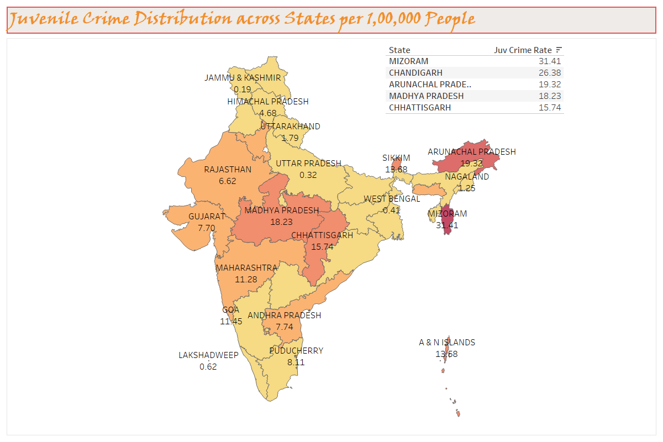

Slide 15
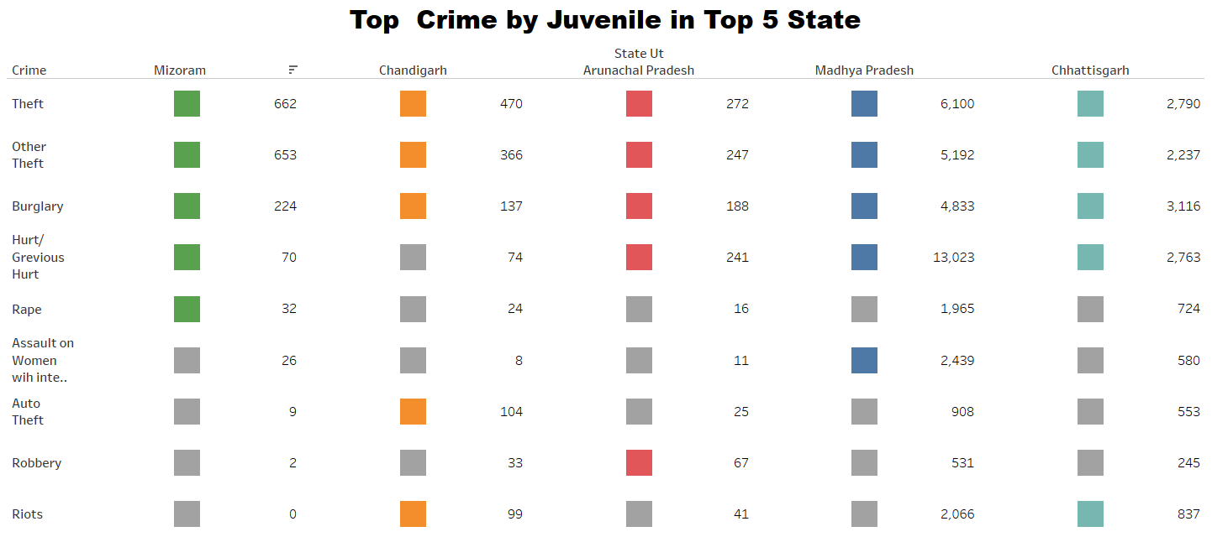

Slide 16
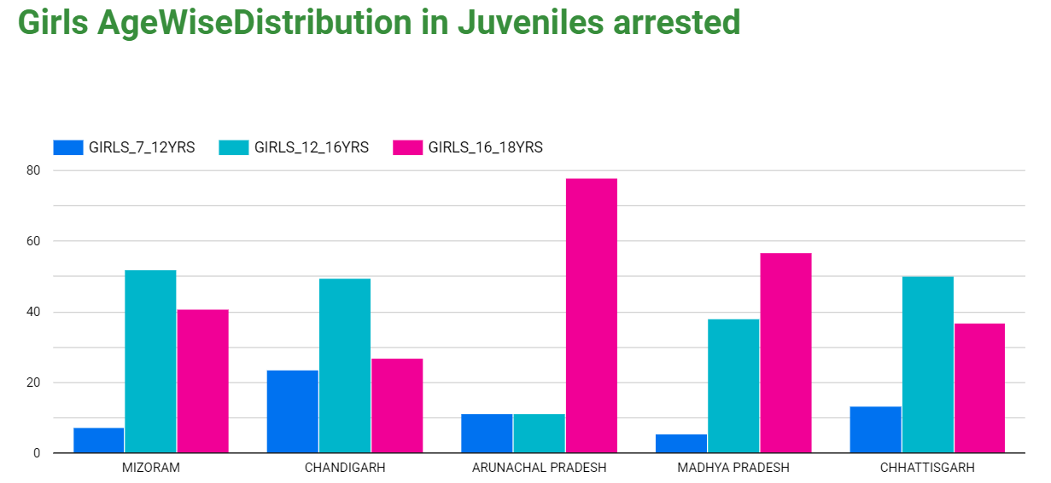
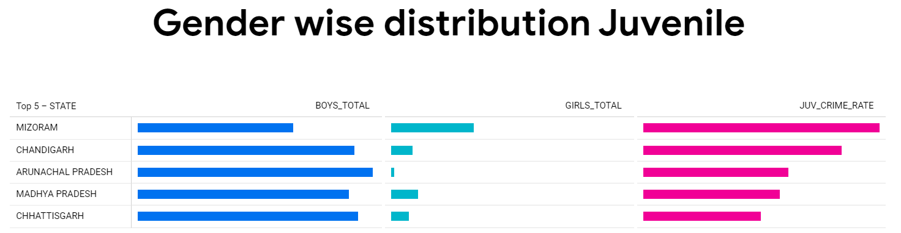
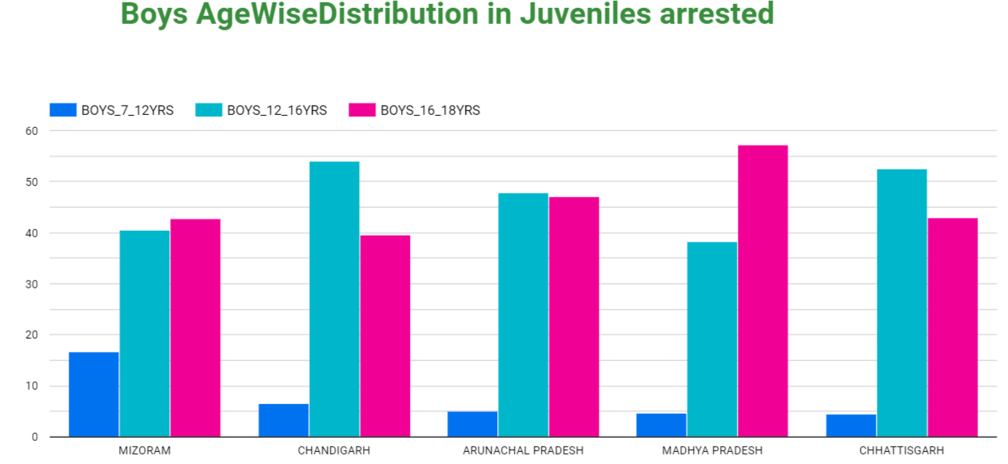

Slide 17
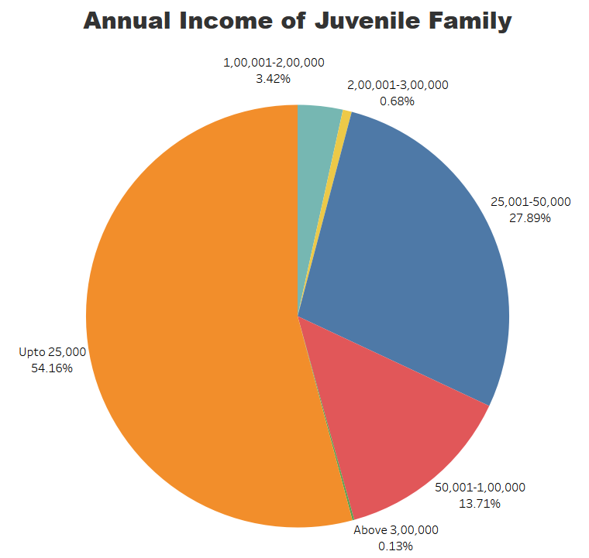
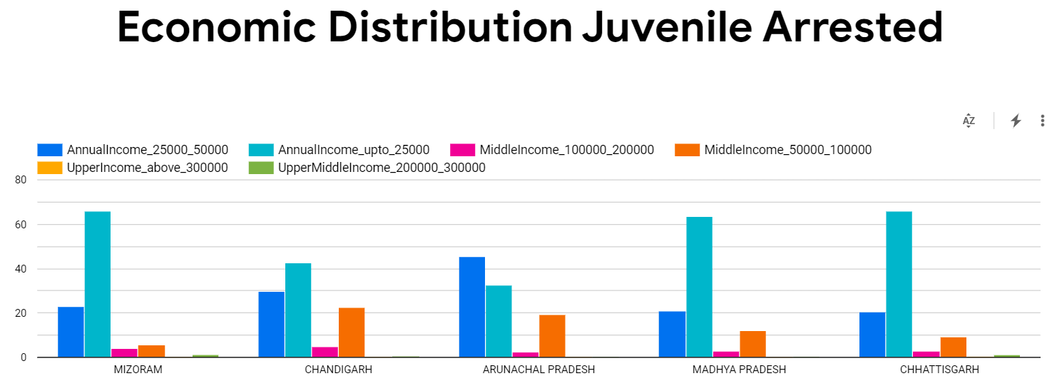

Slide 18
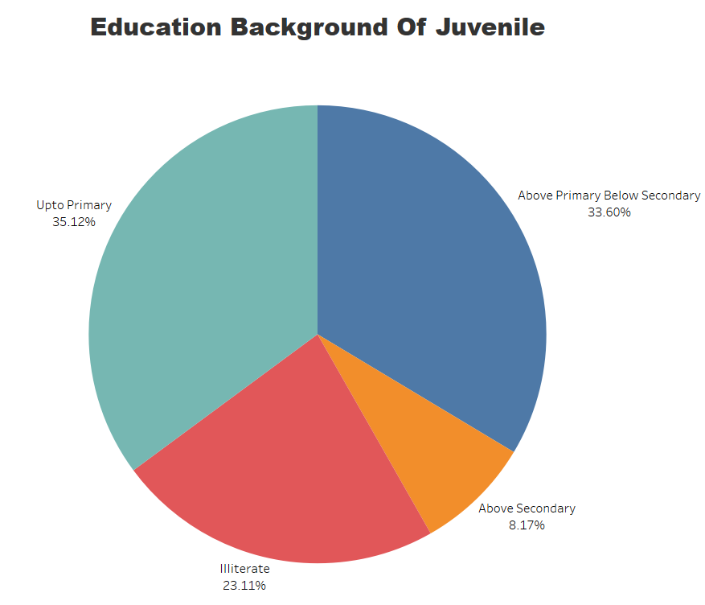
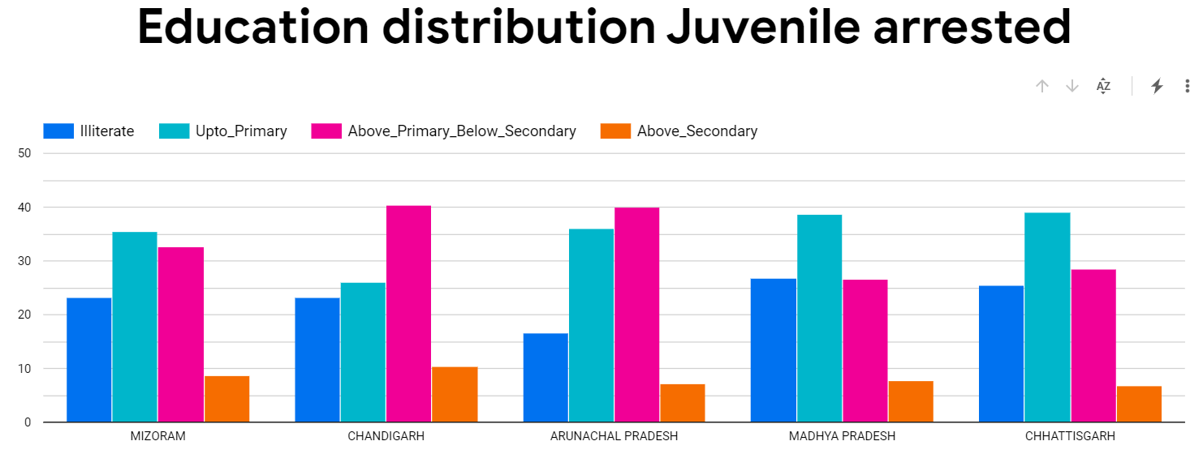

Slide 19
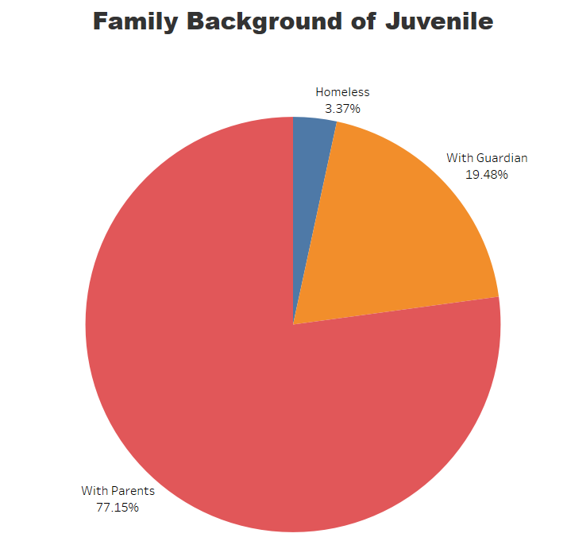
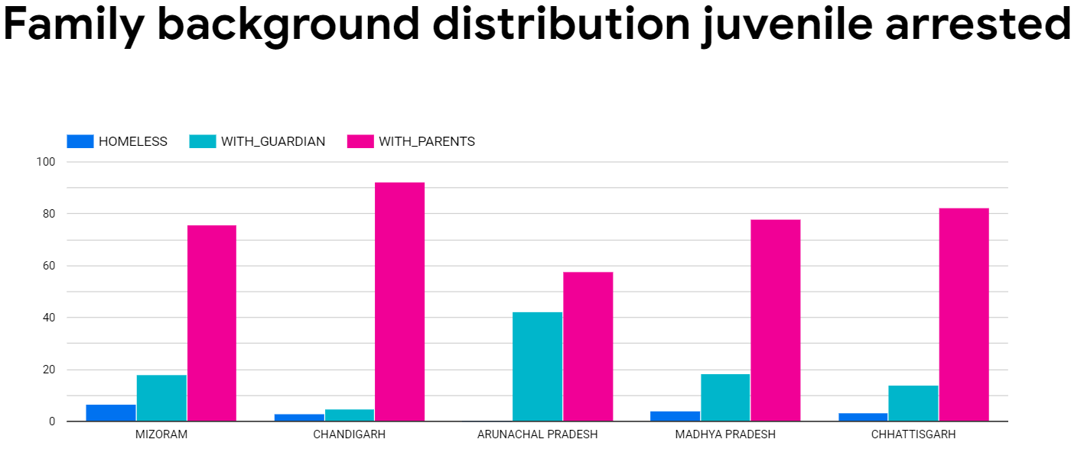

Slide 20
Murder Statistics

Slide 21
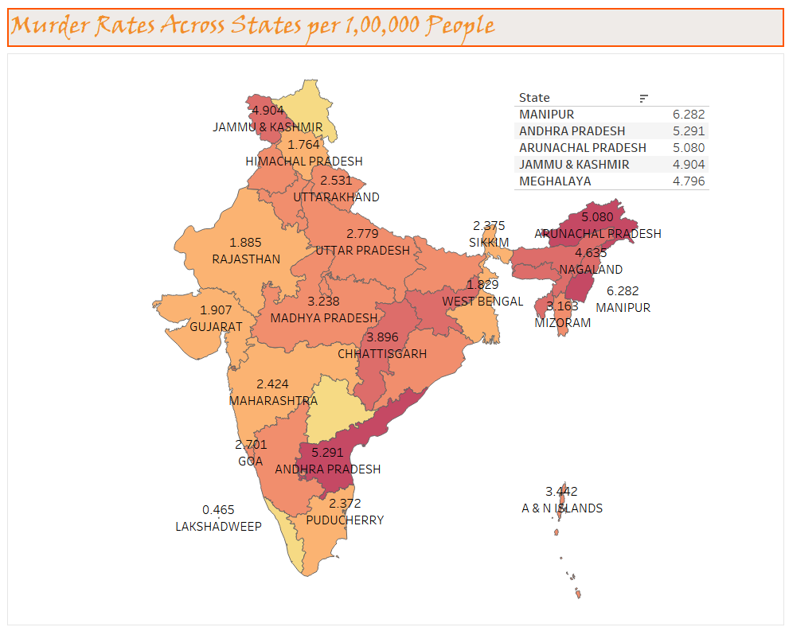

Slide 22
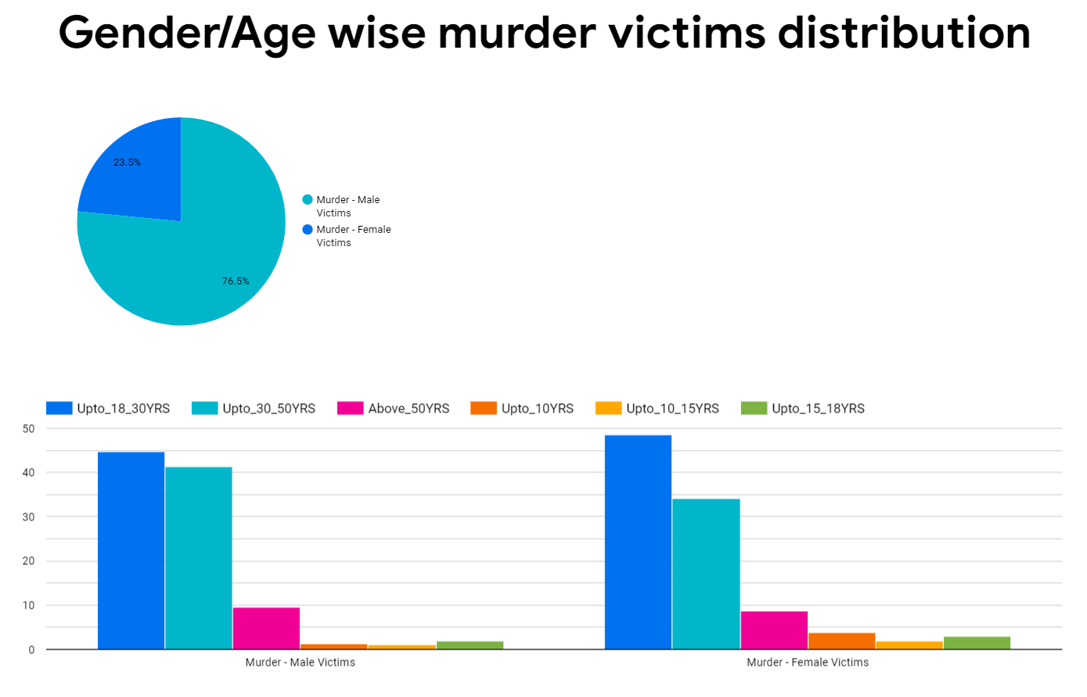
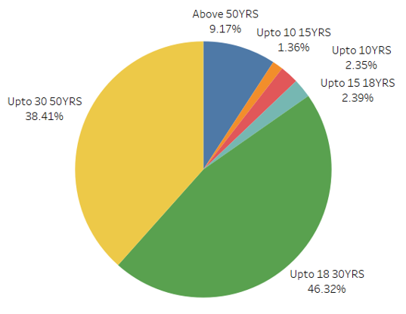

Slide 23
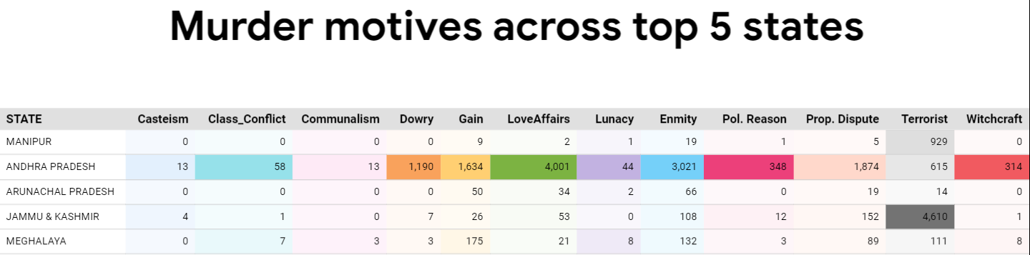

Slide 24
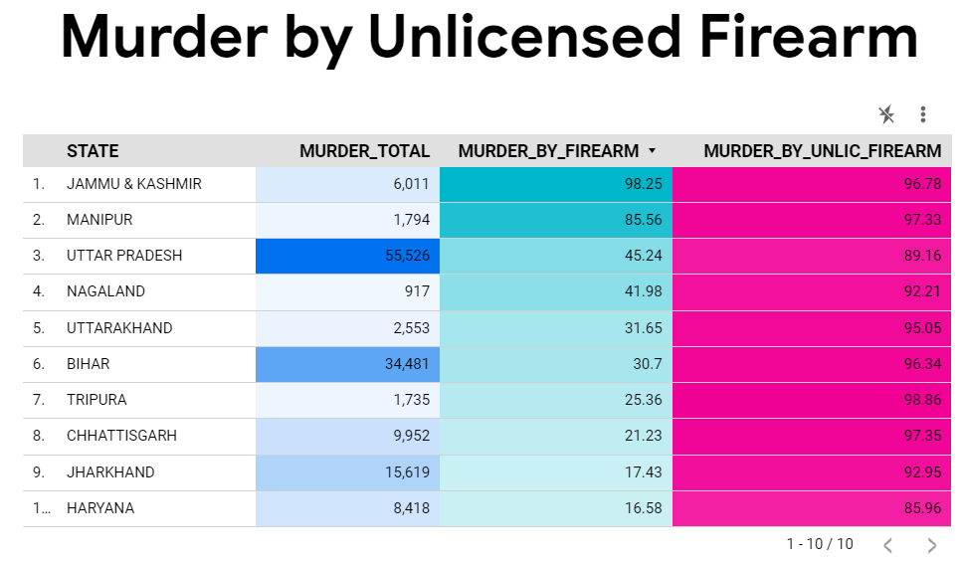
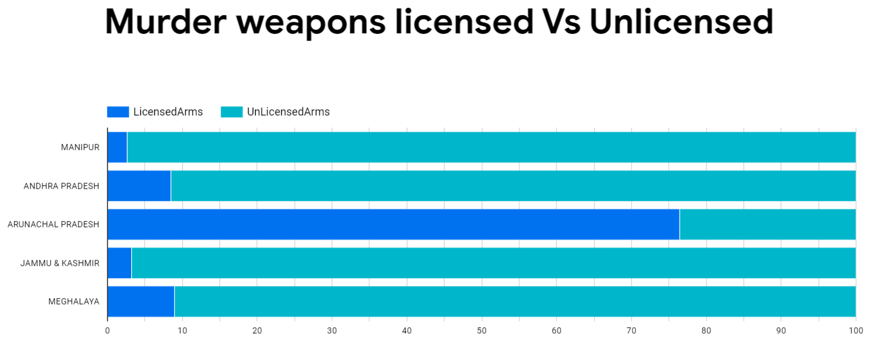

Slide 25
Reference links
DataSet Crime in India : https://www.kaggle.com/datasets/rajanand/crime-in-india
Query : https://ubuffalo-my.sharepoint.com/:w:/g/personal/raviumes_buffalo_edu/ETHlwQstJ9JEqz0Q6g0-BRcBFIe2NhKWeAO1FaZWJLgHpg?e=OEzZdw
Rape Statistics
Top 5 States Age Distribution : Rape Analytics › Top5States_Age Distribution (google.com)
Relationship to Rape Victims : https://datastudio.google.com/reporting/abef2665-5d97-49b3-a649-8856cb9cf3ab
Juvenile Statistics Graph :
Economic Distribution : https://datastudio.google.com/u/0/reporting/cf9f7cdc-6314-43bc-8afe-2b2e374d8b40/page/tEnnC
Education Distribution : https://datastudio.google.com/u/0/reporting/0a3d05a5-00a6-41e9-998c-26866cc10798/page/tEnnC
Family Background : https://datastudio.google.com/u/0/reporting/fdacb994-b07f-4260-bb9c-d9ca98ee05f3/page/tEnnC
Gender Distribution : https://datastudio.google.com/u/0/reporting/17d22257-edc7-4c7a-80e8-21630341d422/page/tEnnC
Girls Age wise Distribution : https://datastudio.google.com/u/0/reporting/699a830a-462e-4d4e-aa0d-62343496cc8b/page/tEnnC
Boys Age wise Distribution : https://datastudio.google.com/u/0/reporting/221b4b4f-1ed8-4ca9-b993-6efbebda7264/page/tEnnC
Murder :
Motive across Top 5 States : https://datastudio.google.com/u/0/reporting/086f7d6e-cbb6-412e-bf5b-5dc972f223f9/page/tEnnC
Murder Unlicensed Firearm Statistics : https://datastudio.google.com/reporting/31890819-11c3-4bad-9143-5cda323a16de
Murder Weapons LicensedVsUnlicensed : https://datastudio.google.com/u/0/reporting/dcbbebb2-b6a3-404d-984f-1d36f0860ddb/page/tEnnC
Murder Gender/Age Distribution: https://datastudio.google.com/reporting/40c5e75a-8abf-4b82-999d-0e9f3695b990
Tableau Files :

